Slide 1
SENIORS HOMEROOM
April 8th, 2024

Slide 2
Agenda: 1. Diploma name check 2. Resumes and HSBP 3. Cap and Gowns 4. Grade Check 5. End of Q3, Start of Q4 plan

Slide 3
Verify your name for you diploma…
A member of your senior team:
Ms. Aaliyah, Mrs. Filippini, Ms. Charbonneau, or Beau will be coming to your homeroom class at some point to verify your name for your diploma.
We want to make sure it’s correct in the graduation program and your actual diploma.
You can also check outside the counseling office.
IF it is NOT correct, let us know ASAP!

Slide 4
Resume and HSBP
Have you completed AND TURNED IN your resume and HSBP?
Your homeroom teacher has a list - make sure you have these two graduation requirements DONE!
If not, Ms. Aaliyah will be calling you down to complete them next week.

Slide 5
Cap and Gown
Have you ordered your Cap and Gown?
Do you still need a Cap and Gown?
These will be distributed on Wednesday May 29th at lunches.
If you need a Cap and Gown – please see Beau.

Slide 6
Finish Strong
There are 43 days left of school for Seniors….
Q3 ends this FRIDAY –
Do NOT wait until the last moment to get your grades up!

Slide 7
3 Key ideas to help you Graduate…
1. Attendance – be here!
2. Ask for help! – we want you to be successful.
3. Practice good habits – turn in work on time, study for tests, complete assignments.
DON’T Procrastinate!!!

Slide 8
Have an F? Are you in iCAN?
Ask for help! – we want you to be graduate.
2. Take the time – it’s worth it!
- Stay 15 minutes after school to get help from a teacher.
- Ask for help from the HUB
- Complete your iCAN

Slide 9
GRADE CHECK! Are you passing all classes? Check your PowerSchool

Slide 10
And one more thing…
If you’re struggling to stay motivated… remember – education pays!
In 2022 - workers age 25 and over made $853 per week, or just over 25 percent more than those who didn’t finish high school.
and earnings improved with every level of education completed.

Slide 11
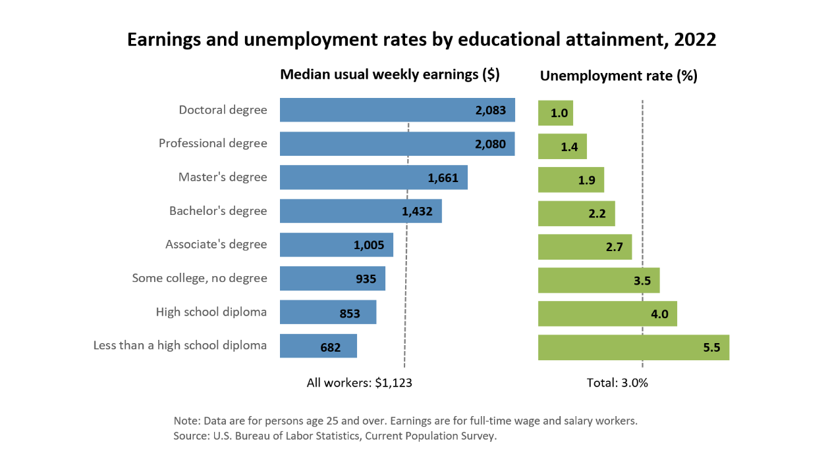
WHY HIGH SCHOOL?

Slide 12
Why are we telling you this?
When you say “I don’t get paid to go to school…”
Actually you do… you will get paid more and have more opportunity with a more education!
We want you to graduate!
(and we’re here to help you do that!)

Slide 13
What’s coming up…
End of Q3 – get those assessments and assignments DONE this WEEK!
Monday April 15th – SENIOR CLASS MTG
- Senior All-nighter info
PROM info
Fines and Fees
Cap and Gown

Slide 14
What’s coming up…
Friday April 19th – Spring Fling MIXER!
8 – 10 PM
May 4th – PROM!
May 6th – AP tests start

Slide 15
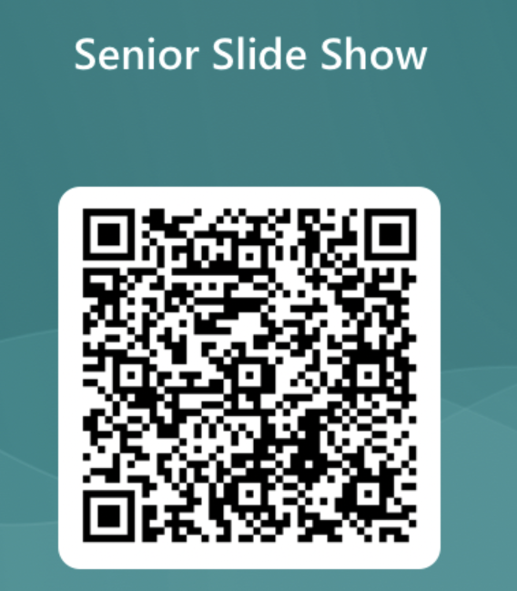
Want to have your photos in the senior slide show?
Use this QR code!

Slide 16
Finish Strong Seniors!

